Slide 1
Natural Language Preprocessing
Week 5

Slide 2
Topics covered in week 5 videos
LSTM Applications
Sentence generation
Sentiment analysis
Machine translation
Advance LSTM structures

Slide 3
Session Agenda
Sentiment analysis
Sentence generation
Machine translation
NMT with attention
LSTM structures
Case study
Questions

Slide 4
Sentiment Analysis

Slide 5
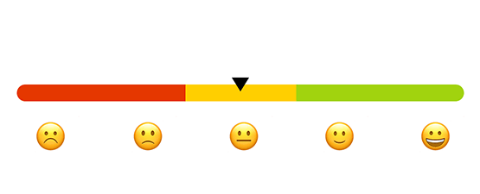
Sentiment analysis
Image source:hackernoon

Slide 6
Sentiment analysis
Very common for customer review or new article analysis
Output before the end can be discarded (not used for backpropagation)
It is a many-to-one task
Positive
LSTM
LSTM
LSTM
LSTM
LSTM
LSTM
Embed
Embed
Embed
Embed
Embed
Embed
Very
pleased
with
their
service
<END>

Slide 7
Sentence Generation

Slide 8

Sentence generation
Very common for image captioning
Input is given only in the beginning
Sequence output (e.g. image captioning takes an image and outputs a sentence of words)
Image captioning is a one-to-many task
A
boy
swimming
in
water
<END>
LSTM
LSTM
LSTM
LSTM
LSTM
LSTM
CNN

Slide 9
Machine Translation

Slide 10
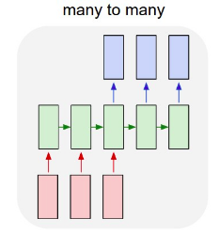
Machine translation
Sequence input and sequence output (e.g. Machine Translation: an RNN reads a sentence in English and then outputs a sentence in French)
It is a many-to-many task

Slide 11
Machine translation
One could also feed in the output to the next instance input to predict a coherent structure
<START>
मैं
जा
रहा
हूँ
<END>
LSTM
LSTM
LSTM
LSTM
LSTM
LSTM
LSTM
LSTM
LSTM
Embed
Embed
Embed
Embed
Embed2
Embed2
Embed2
Embed2
I
am
going
<END>

Slide 12
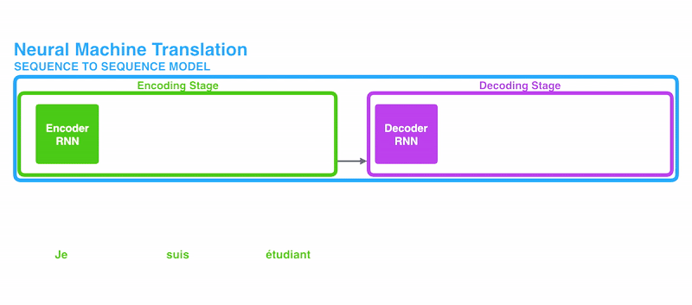
How it works?

Slide 13
NMT with attention
When you predict “राहुल”, it's obvious that this name is the result of the word “Rahul” present in the input English sentence regardless of the rest of the sentence. We say that while predicting “राहुल”, we pay more attention to the word “Rahul” in the input sentence.
Similarly while predicting the word “चांगला”, we pay more attention to the word “good” in the input sentence and so on.
Hence the name “ATTENTION”.

Slide 14
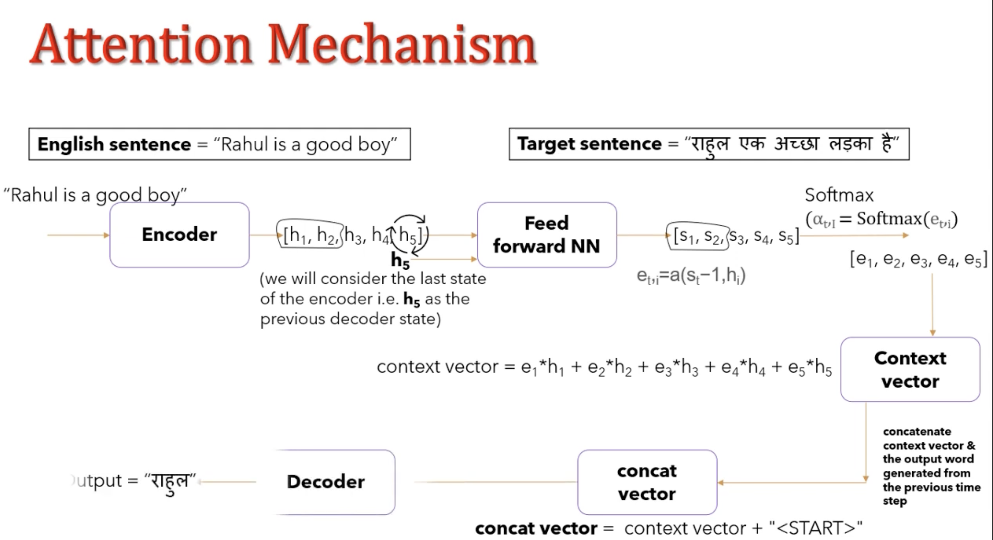

Slide 15
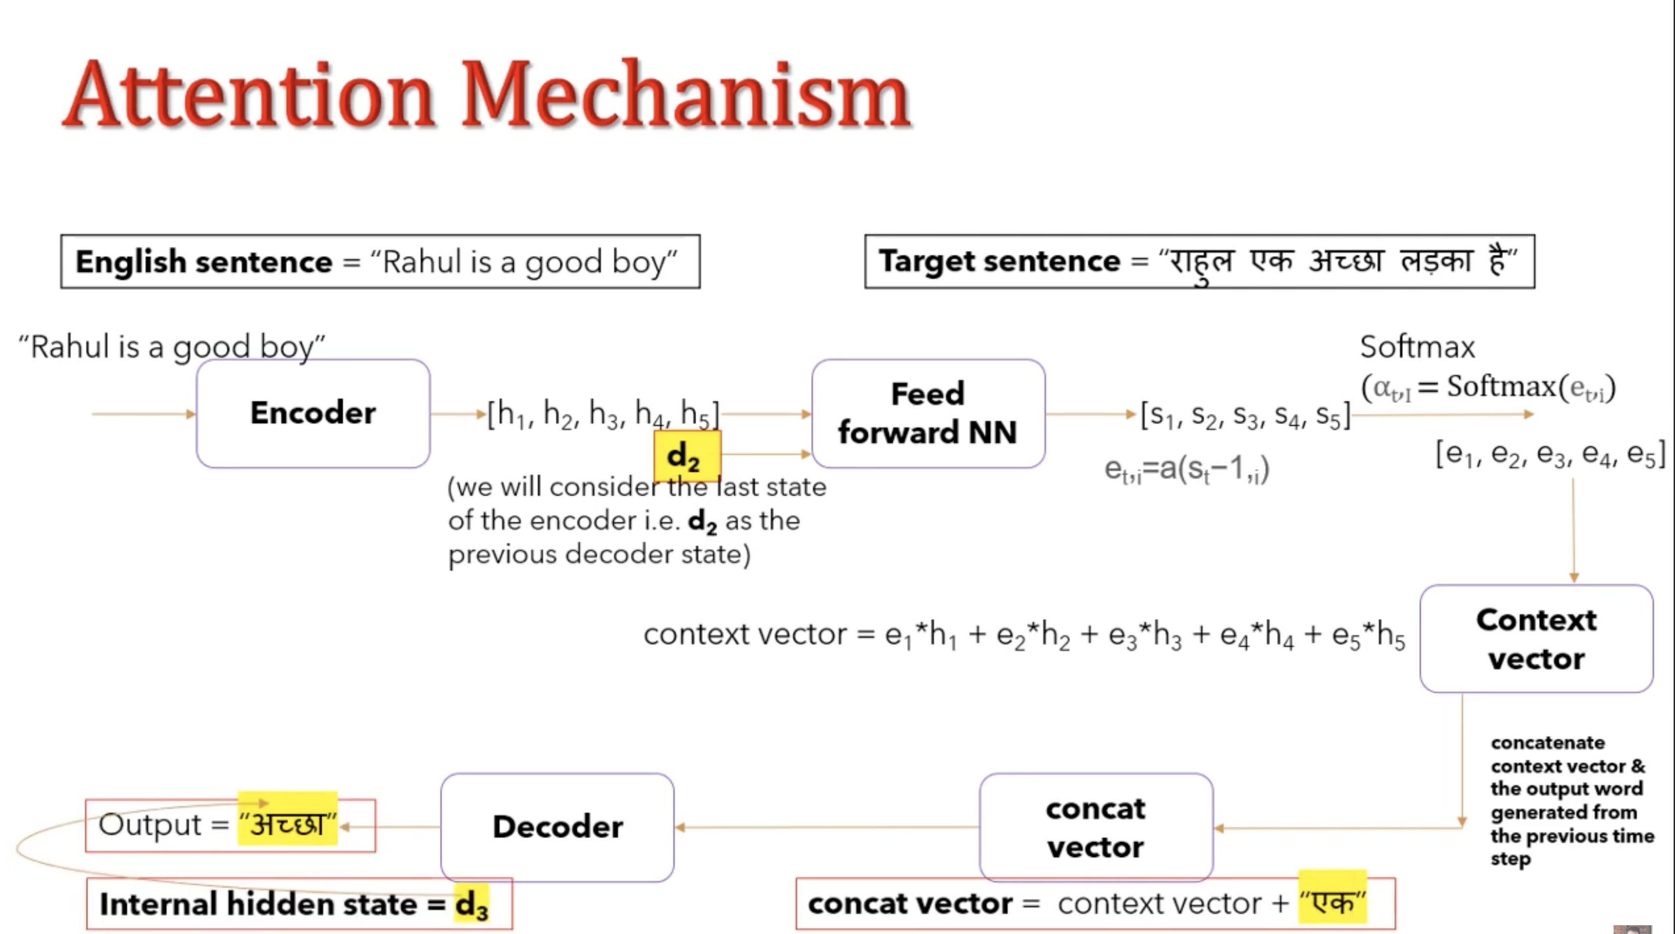

Slide 16
Central idea behind attention
As human beings we are quickly able to understand these mappings between different parts of the input sequence and corresponding parts of the output sequence. However it’s not that straight-forward for neural networks to automatically detect these mappings.
Thus the Attention mechanism is developed to “learn” these mappings through Gradient Descent and Back-propagation.
The central idea behind Attention is not to throw away those intermediate encoder states but to utilize all the states in order to construct the context vectors required by the decoder to generate the output sequence.

Slide 17
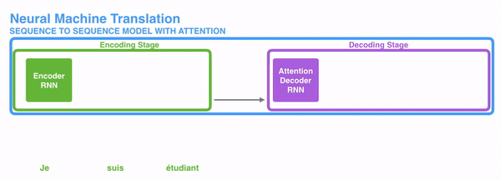
NMT with attention mechanism
An attention model differs from a classic sequence-to-sequence model in two main ways:
First, the encoder passes a lot more data to the decoder. Instead of passing the last hidden state of the encoding stage, the encoder passes all the hidden states to the decoder:

Slide 18
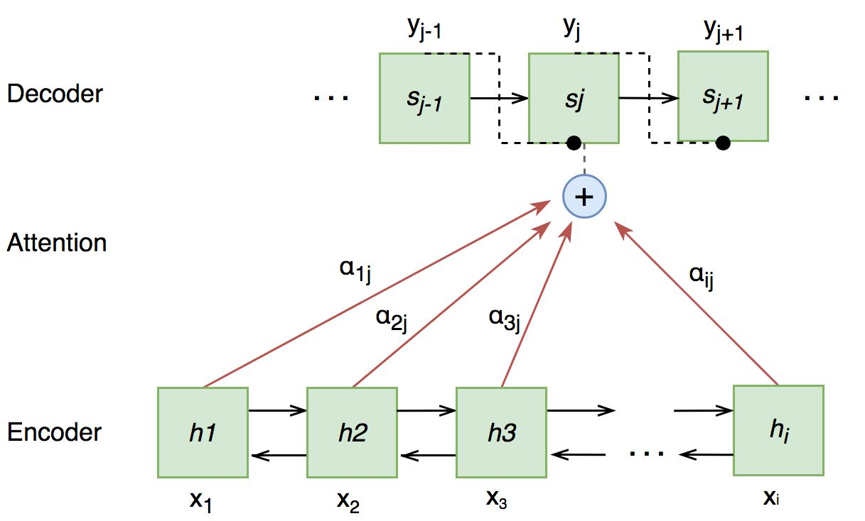
Attention based encoder-decoder

Slide 19
NMT with attention - total architecture
मैं
जा
रहा
हूँ
<END>
Decoder
Decoder
Decoder
Decoder
Decoder
Context
LSTM2
LSTM2
LSTM2
LSTM2
LSTM2
Embed2
Embed2
Embed2
Embed2
LSTM
LSTM
LSTM
LSTM
Embed
Embed
Embed
Embed
I
am
going
<END>

Slide 20
Advance LSTM structures

Slide 21
Multi layer LSTM
y_{n-3}
y_{n-2}
y_{n-1}
y_{n}
Second hidden layer →
LSTM2
LSTM2
LSTM2
LSTM2
First hidden layer →
LSTM1
LSTM1
LSTM1
LSTM1
x_{n-3}
x_{n-2}
x_{n-1}
x_{n}

Slide 22
Bidirectional LSTM
Many problems require a reverse flow of information as well
For example, POS tagging may require context from future words
y_{n-3}
y_{n-2}
y_{n-1}
y_{n}
Backward layer →
LSTM2
LSTM2
LSTM2
LSTM2
Forward layer →
LSTM1
LSTM1
LSTM1
LSTM1
x_{n-3}
x_{n-2}
x_{n-1}
x_{n}

Slide 23
Problems in LSTM
Inappropriate model
Identify the problem: One-to-many, many-to-one etc.
Loss only for outputs that matter
Separate LSTMs for separate languages
High training loss
Model not expressive
Too few hidden nodes
Only one hidden layer
Overfitting
Model has too much freedom
Too many hidden nodes
Too many blocks
Too many layers
Not bi-directional

Slide 24

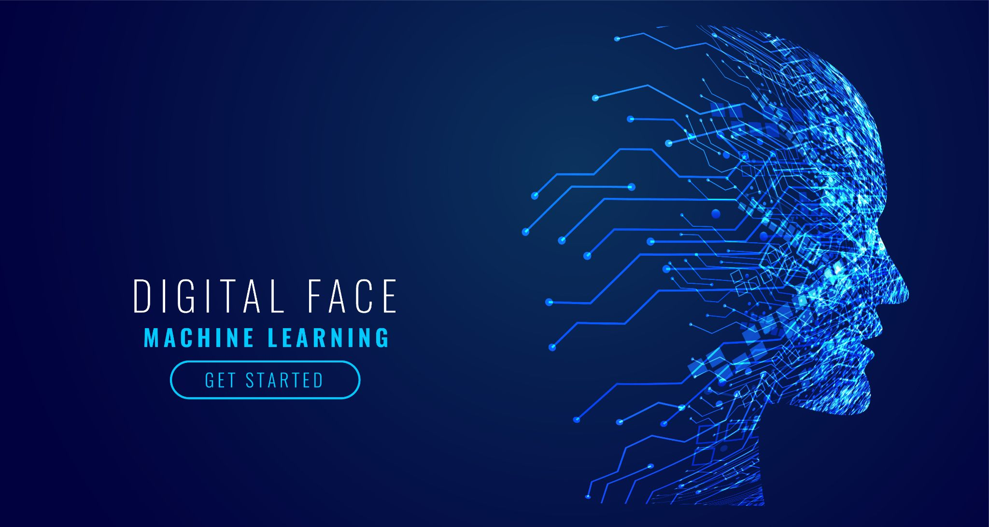
AIML @WORK
PGPAIML @ Great Learning
Enabling Learners to Apply the AI/ML Concepts at Work
Apply AIML at your workplace to gain some instant benefits:
Get noticed by your management with your outstanding analysis backed by data science.
Create an impact in your organization by taking up small projects/initiatives to solve critical issues using data science.
Network with members from the data science vertical of your organization and seek opportunities to contribute in small projects.
Share your success stories with us and the world to position yourself as a subject matter expert in data science.
AIML Operations | AIMLAW
@Great Learning Proprietary Content. All rights reserved. Unauthorized use or distribution prohibited

